Slide 1

WEB DEVELOPMENT
ACTIVATION OF NOTIFICATIONS
FOR INSTAGRAM User Brave Management

Slide 2
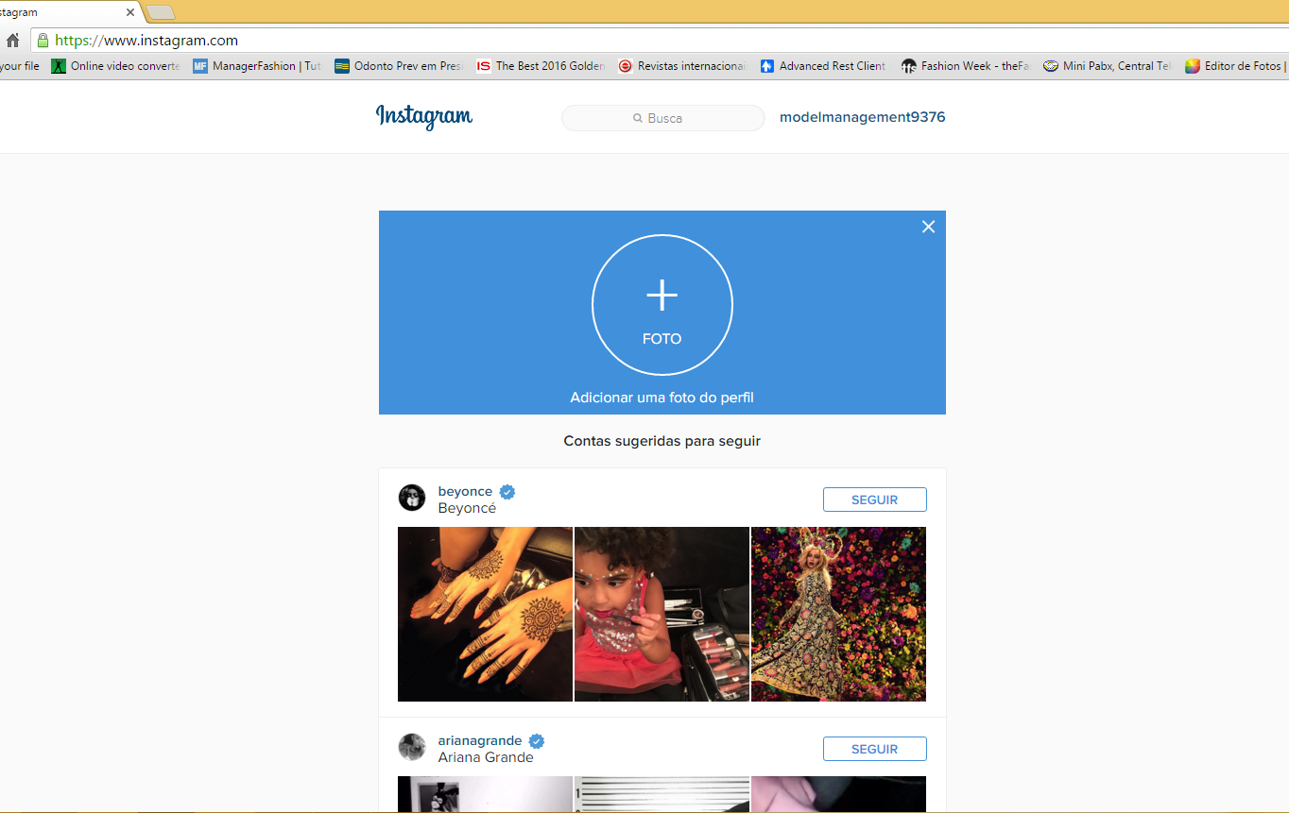

1
Log in from a browser
To your Instagram account

Slide 3

2
In the address bar
Add "/ developer”

Slide 4
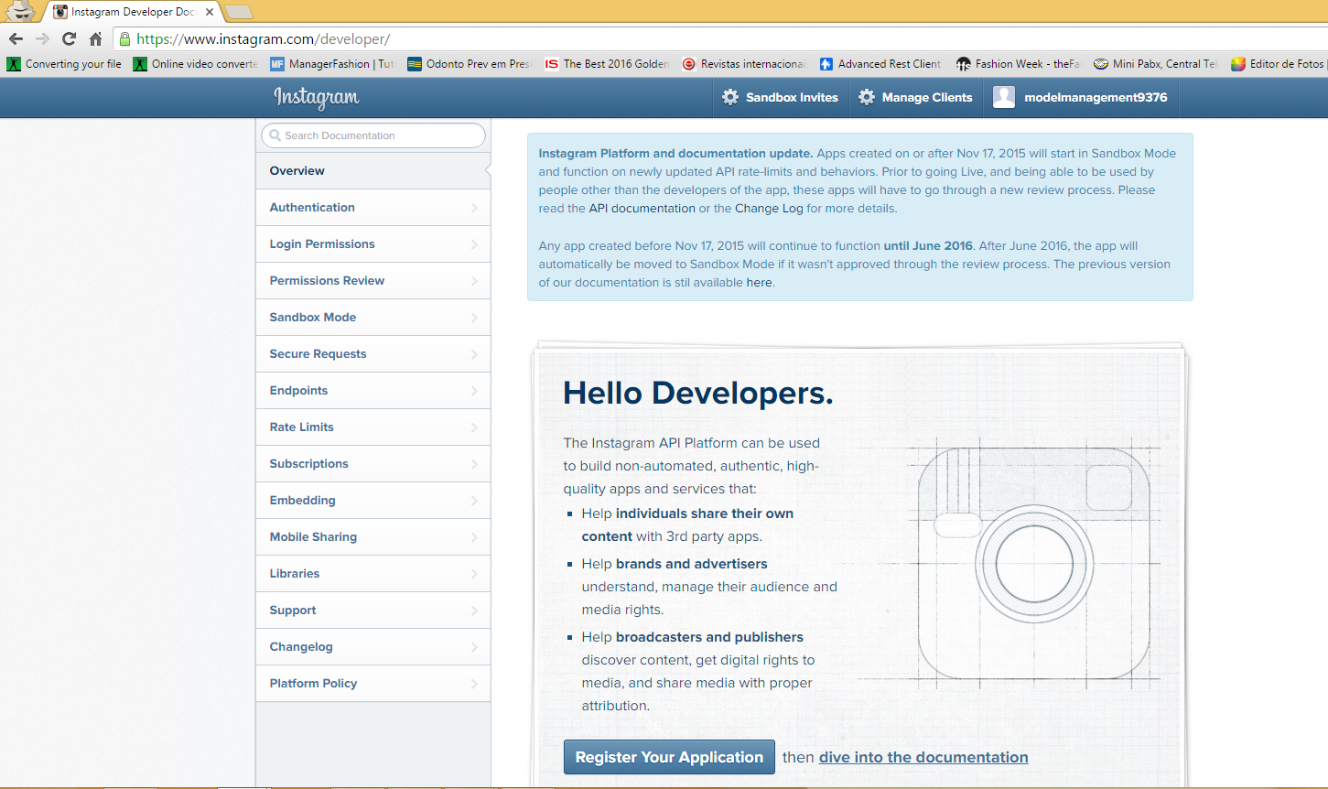
3
Click on "Sandbox Invites"

Slide 5
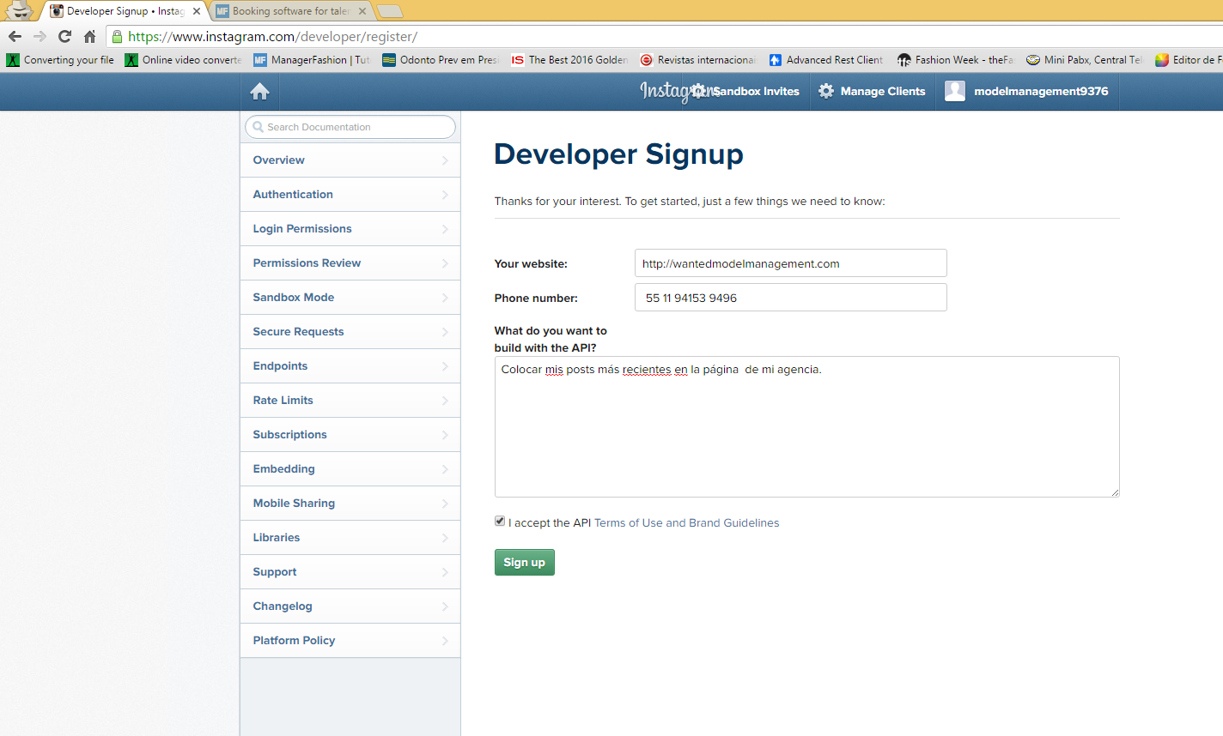
4
Fill out the form with
The same example data
Your Website
Your number
“Post my most recent posts
On my agency page”
5
Click on "Sign up"

Slide 6
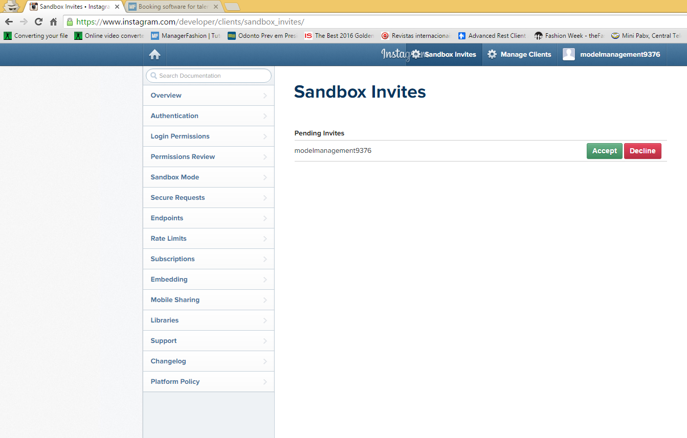
6
Click on SandBox again
7
Click on "Accept”

Slide 7
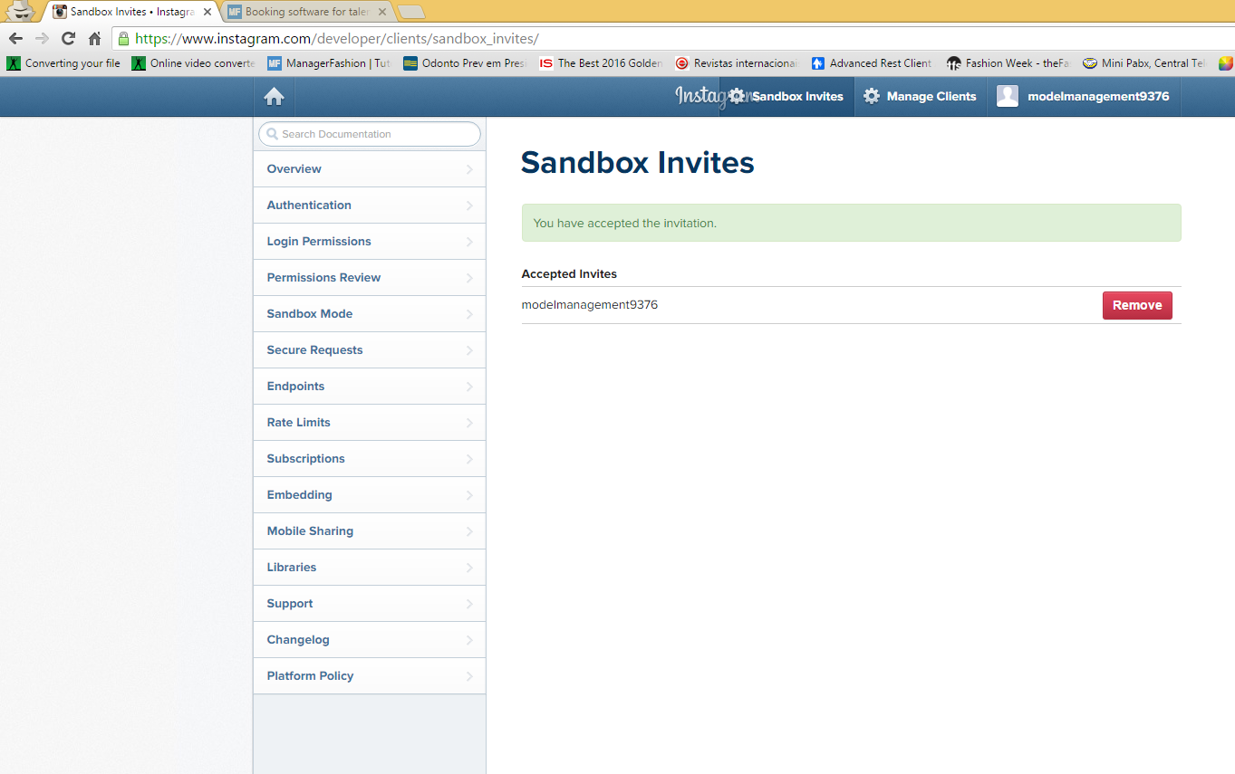

Slide 8
8
Access the following link
CLICK ON
or
Copy and paste this link into your browser :
https://api.instagram.com/oauth/authorize/?client_id=e924c78f3f604219a9d27facd3fd9755&redirect_uri=http://www.wantedmodelmanagement.com?user=wanted&response_type=token&scope=public_content

Slide 9
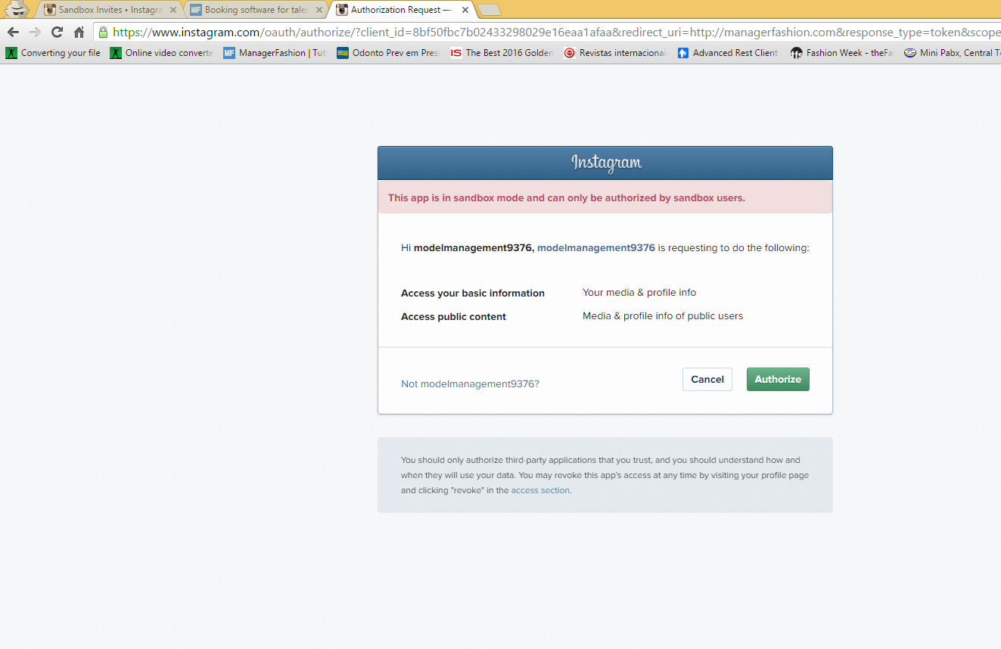
The previous link
9
Click on "Authorize”

Slide 10
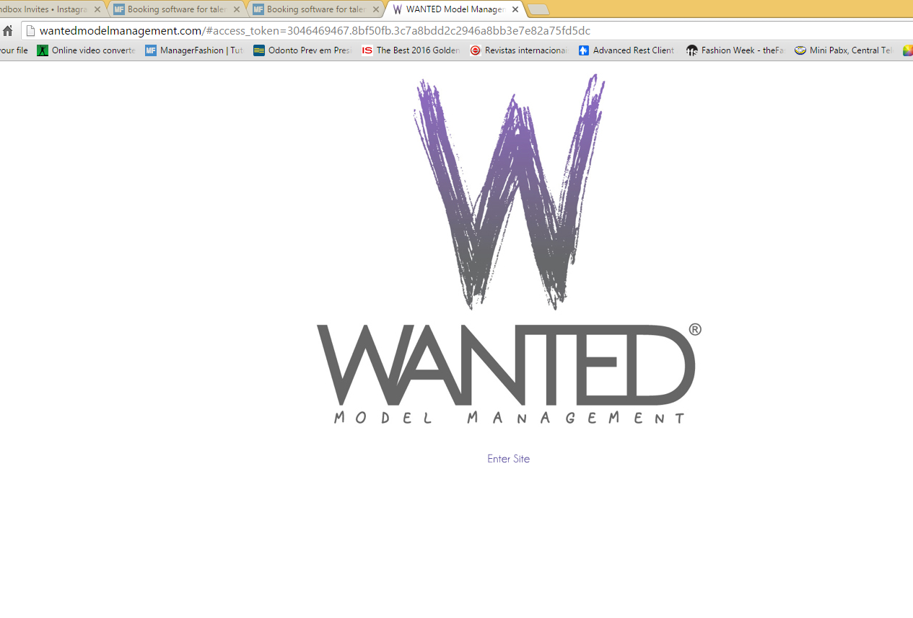
10
Copy the link and send it to us:
Support@managerfashion.com

